Slide 1
Analysis of the efficiency of Rappi’s campaigns

Slide 2

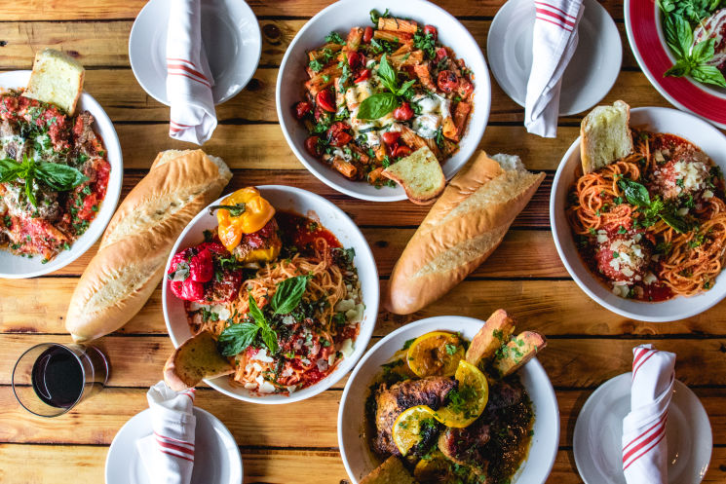
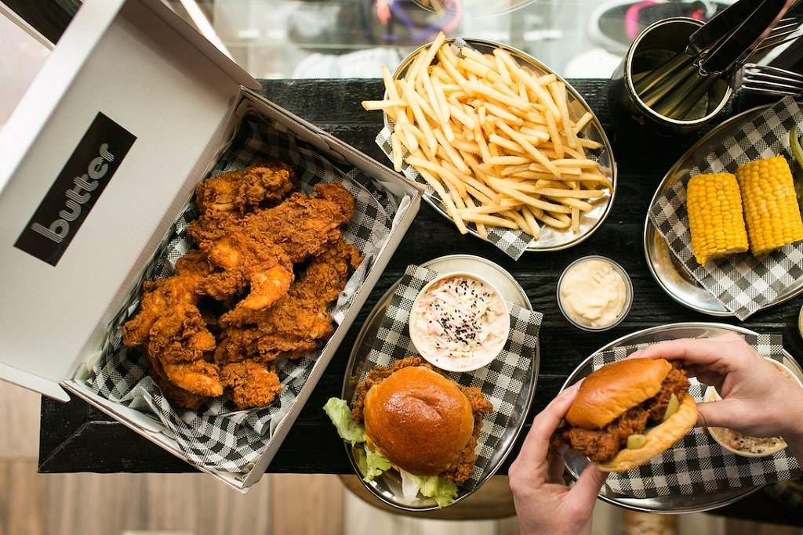
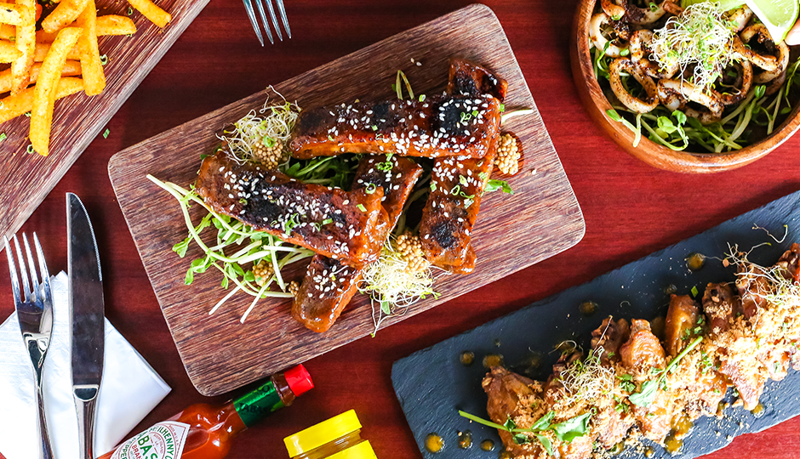
Hypothetical situation
Notes:
Mariana

Slide 3
Reality
18 to 30 year- olds are the most likely not to take the offer
Marketing campaigns through push/sms notifications are the most popular within older age groups
Notes:
Mariana

Slide 4



Who are we?
Iñaki Cabo
Computer & Industrial Engineering
20 years old
Bruno López
Business Engineering
23 years old
Mariana Pérez-Cong
Applied Mathematics
21 years old

Slide 5



Business model
+
=
“Order almost anything they want with a super app concept that will deliver it to them in 30 minutes in exchange for a buck" - S. Mejia.
Order groceries, food or drugstore medications. Also send or receive cash, and even transport personal belongings.
Rappi generates revenue by taking an average of 17 percent of each retail transaction.
Couriers are independent contractors, not employees. No fixed income.
Notes:
(Bruno)
Rappi -> 1st unicorn from Latin America, 9 countries.
“super app” to order almost anything and receive it within 30 minutes
Revenue = 17% of each transaction
Couriers = independent contractors, delivery fee + tips.
20,000 couriers from Mexico to Argentina. Rappi has partnerships with 50,000 businesses. 28 cities where it operates
https://www.bloomberg.com/news/articles/2018-10-03/colombian-super-app-is-a-unicorn-it-wants-to-be-a-tech-giant

Slide 6
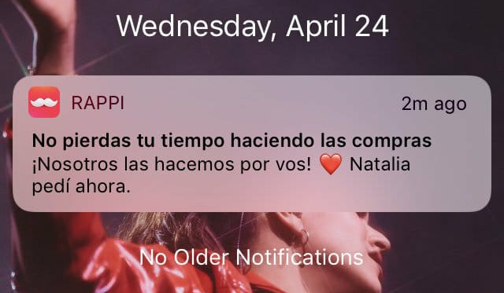
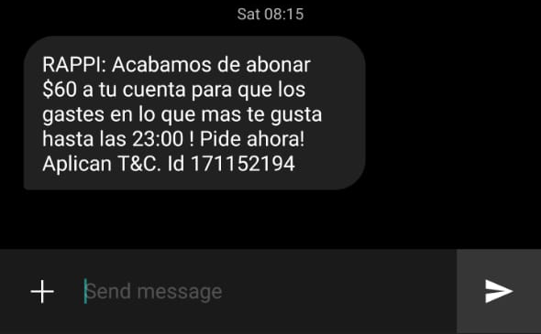
Push vs SMS
Pros:
Direct link between message and app.
Cons:
Needs to have app installed.
Pros:
Could have app uninstalled and still receive the message.
Cons:
Can be annoying.
Notes:
(Bruno)
Make things clear.
Push = app notifications.
SMS = regular text messages
Push adv = direct link Push disadv = uninstalled don’t receive
SMS adv = receive it no matter what
SMS disadv = annoying

Slide 7
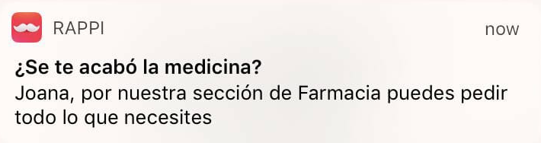
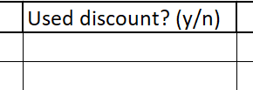
Assumptions
X
We have no way to see if the user applied the promotion, but as many promotions have a two hour time limit, we are assuming that the orders that were created within two hours from when the promotion was sent are using a discount code.
Notes:
(Bruno)
No direct link
Time limit of 2 hours

Slide 8
Data Sets
Orders data set: orders in Mexico during the month of june
Data: order id, time and day of order, total charge, place of delivery (latitude, longitude), user id, user gender and user birth date
Cleaning the data:
Extracting the orders from Mexico City: finding the places of delivery that matched the coordinates of Mexico City
Notes:
Iñaki
We based our research in two data sets.
The first one contained all the orders created in mexico from the last month, so took only the ones that were created inside Mexico City.

Slide 9
Data Sets
Campaigns data sets: campaigns in Mexico during the month of june
Data: campaign id, created at, state, media type, user id,
Cleaning the data:
Getting rid of extra columns and changing the format of the media type column
Notes:
Iñaki
Also, we had the entire list of users that received a campaign during the last month in mexico.
This information was already cleaned and we just mapped the media type to the correct name

Slide 10
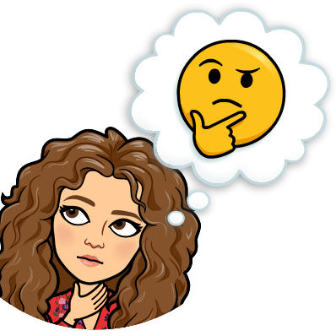
Main Questions
How effective are these campaigns?
Are they being efficiently sent out?
Is Rappi taking in consideration its customers trends?

Slide 11
Secondary Questions
Customer Distribution | How are the Age groups distributed How are the genders distributed Is there a more predominant gender in each age group?
Campaign and media type efficiency | How much does each age group spend with and without a campaign? Is there a difference between men and women? Overall which media type has a better performance in the customers? Which media type is more effective within different age groups? What time is best to send a campaign? Which days are best to send a campaign?
Notes:
MAriana

Slide 12
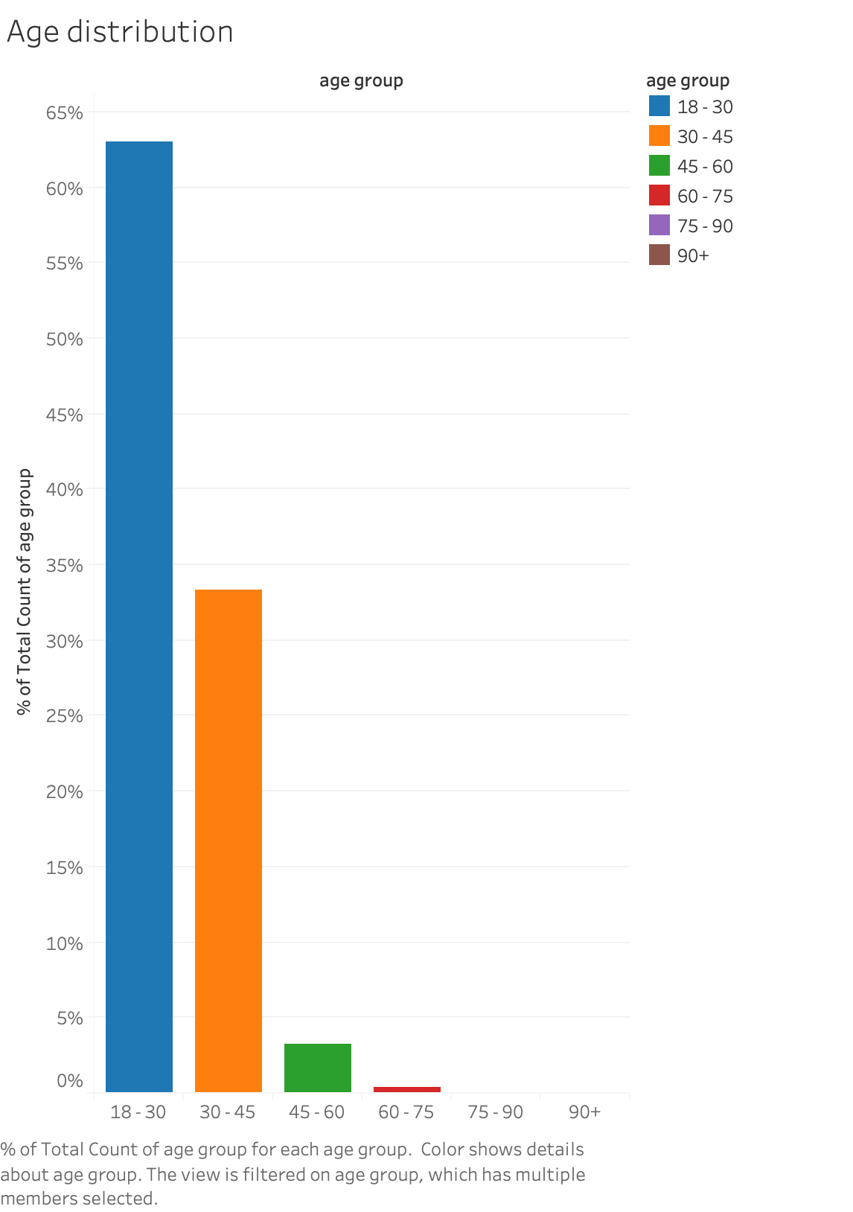

Most of Rappi’s orders came from people between 18 and 30 years old
Notes:
(Bruno) Analyzing the clients (1)
People that ordered in June
18-30 -> blue -> 63%
30-45 -> orange -> 32%
everything else -> 5%

Slide 13
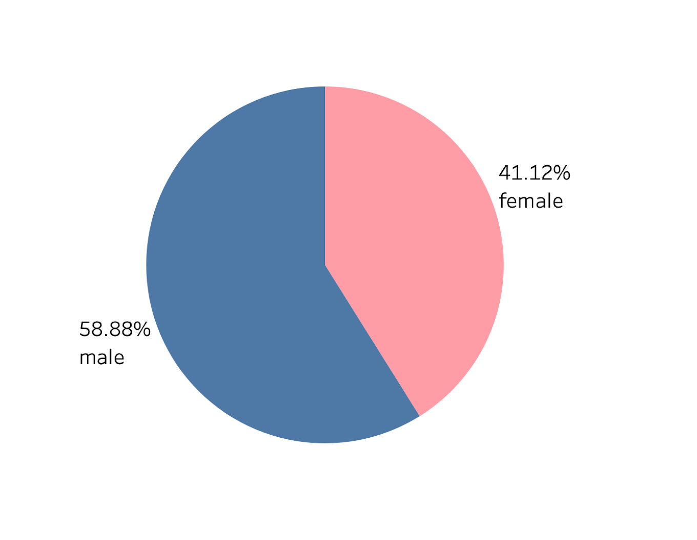
Most of June’s purchases were made my men.
Notes:
(Bruno) Analyzing the clients (2)
ORDERS IN JUNE
men -> blue -> almost 60%
women -> pink -> little bit over 40%

Slide 14
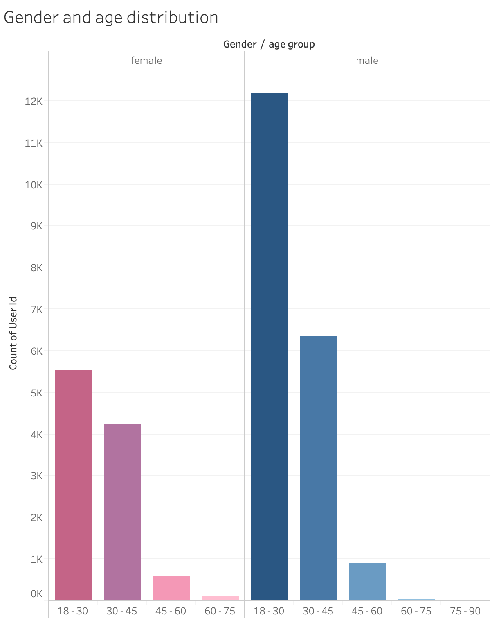

The population of 18-30 year old males is significantly larger than that of women’s
Notes:
(Bruno) Analyzing the clients (3)
Men purchased more in June (last slide)
Biggest difference is in 18-30 where men ordered more than twice as much than women,
with more than 12,000 orders and women with 5,500 orders

Slide 15
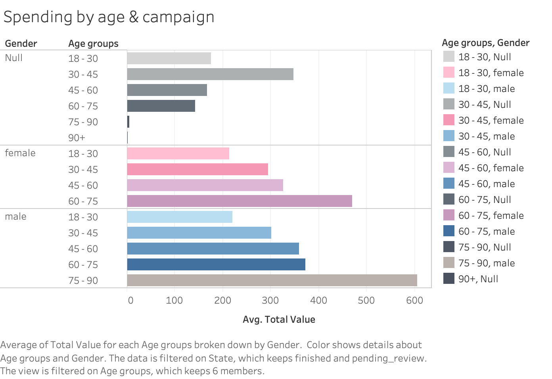

Among older age groups, women tend to spend more than men
Notes:
Mariana

Slide 16
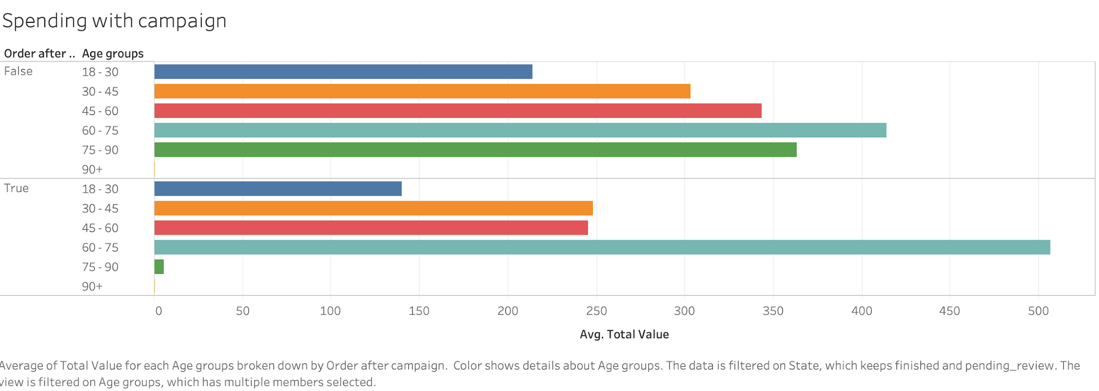

The 60-75 age group tends to spend more money when using a campaign whereas other groups tend to spend less
Notes:
Mariana

Slide 17
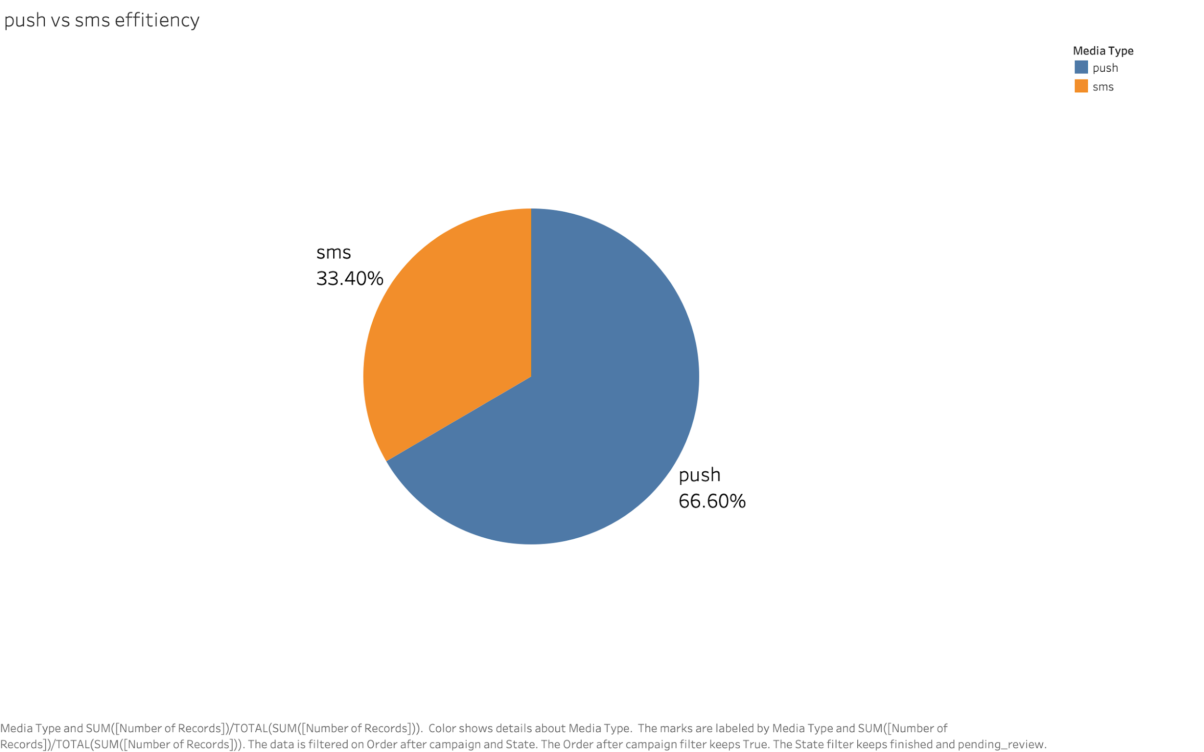
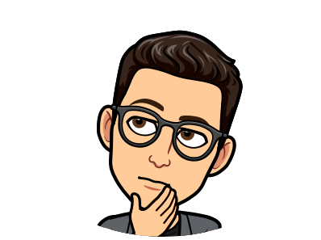
Average purchases made with sms campaigns vs. purchases made with push campaigns
In general, customers are more likely to make a purchase if they receive a push notification
Notes:
Iñaki
As we saw, rappi sends two main notifications, sms and push. But mainly users create more orders when they receive a push notification rather than a sms.
From all the users that created an order after receiving a campaign two thirds were because of a push.

Slide 18
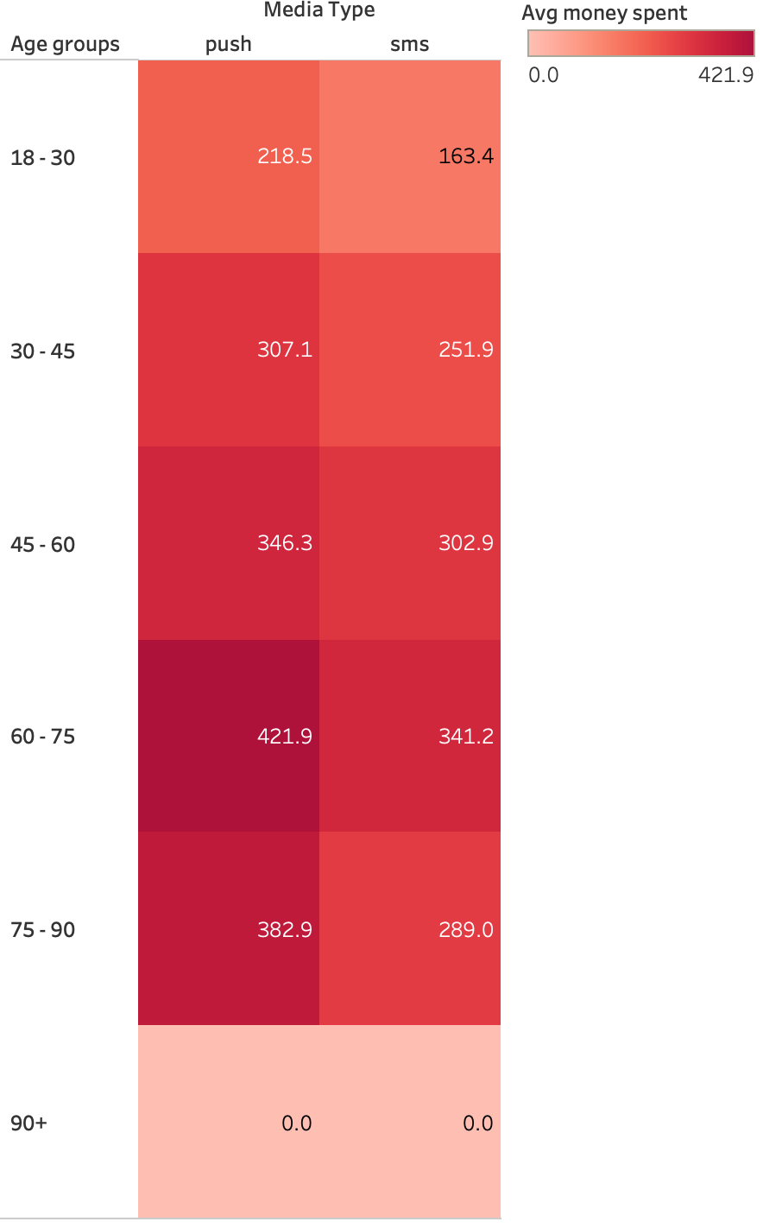

Push notifications are the most effective
Notes:
Iñaki
Also we wanted to compare how different age groups spent when they receive both notifications. As we can see, users tend to spend more when a push notification was sent, also we found that 60 to 75 year old’s are the ones who spend the most.

Slide 19
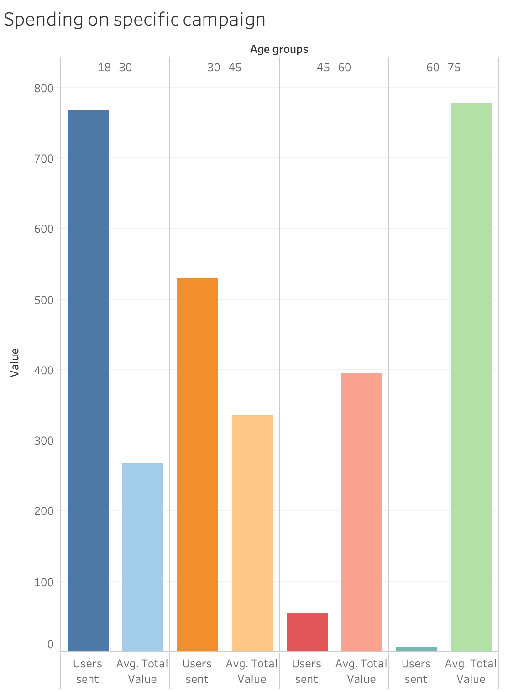

Alcohol campaign
Campaigns are not focusing on the right age groups
Notes:
Iñaki
Now, we knew how users spent overall in the month, but what about how rappi selected the users for a campaign.
This is where we were impressed, in an alcohol campaign most users where between 18 to 30 years old, but they were the ones that spent the least, on the other hand, 60 to 75 years old spent the most

Slide 20
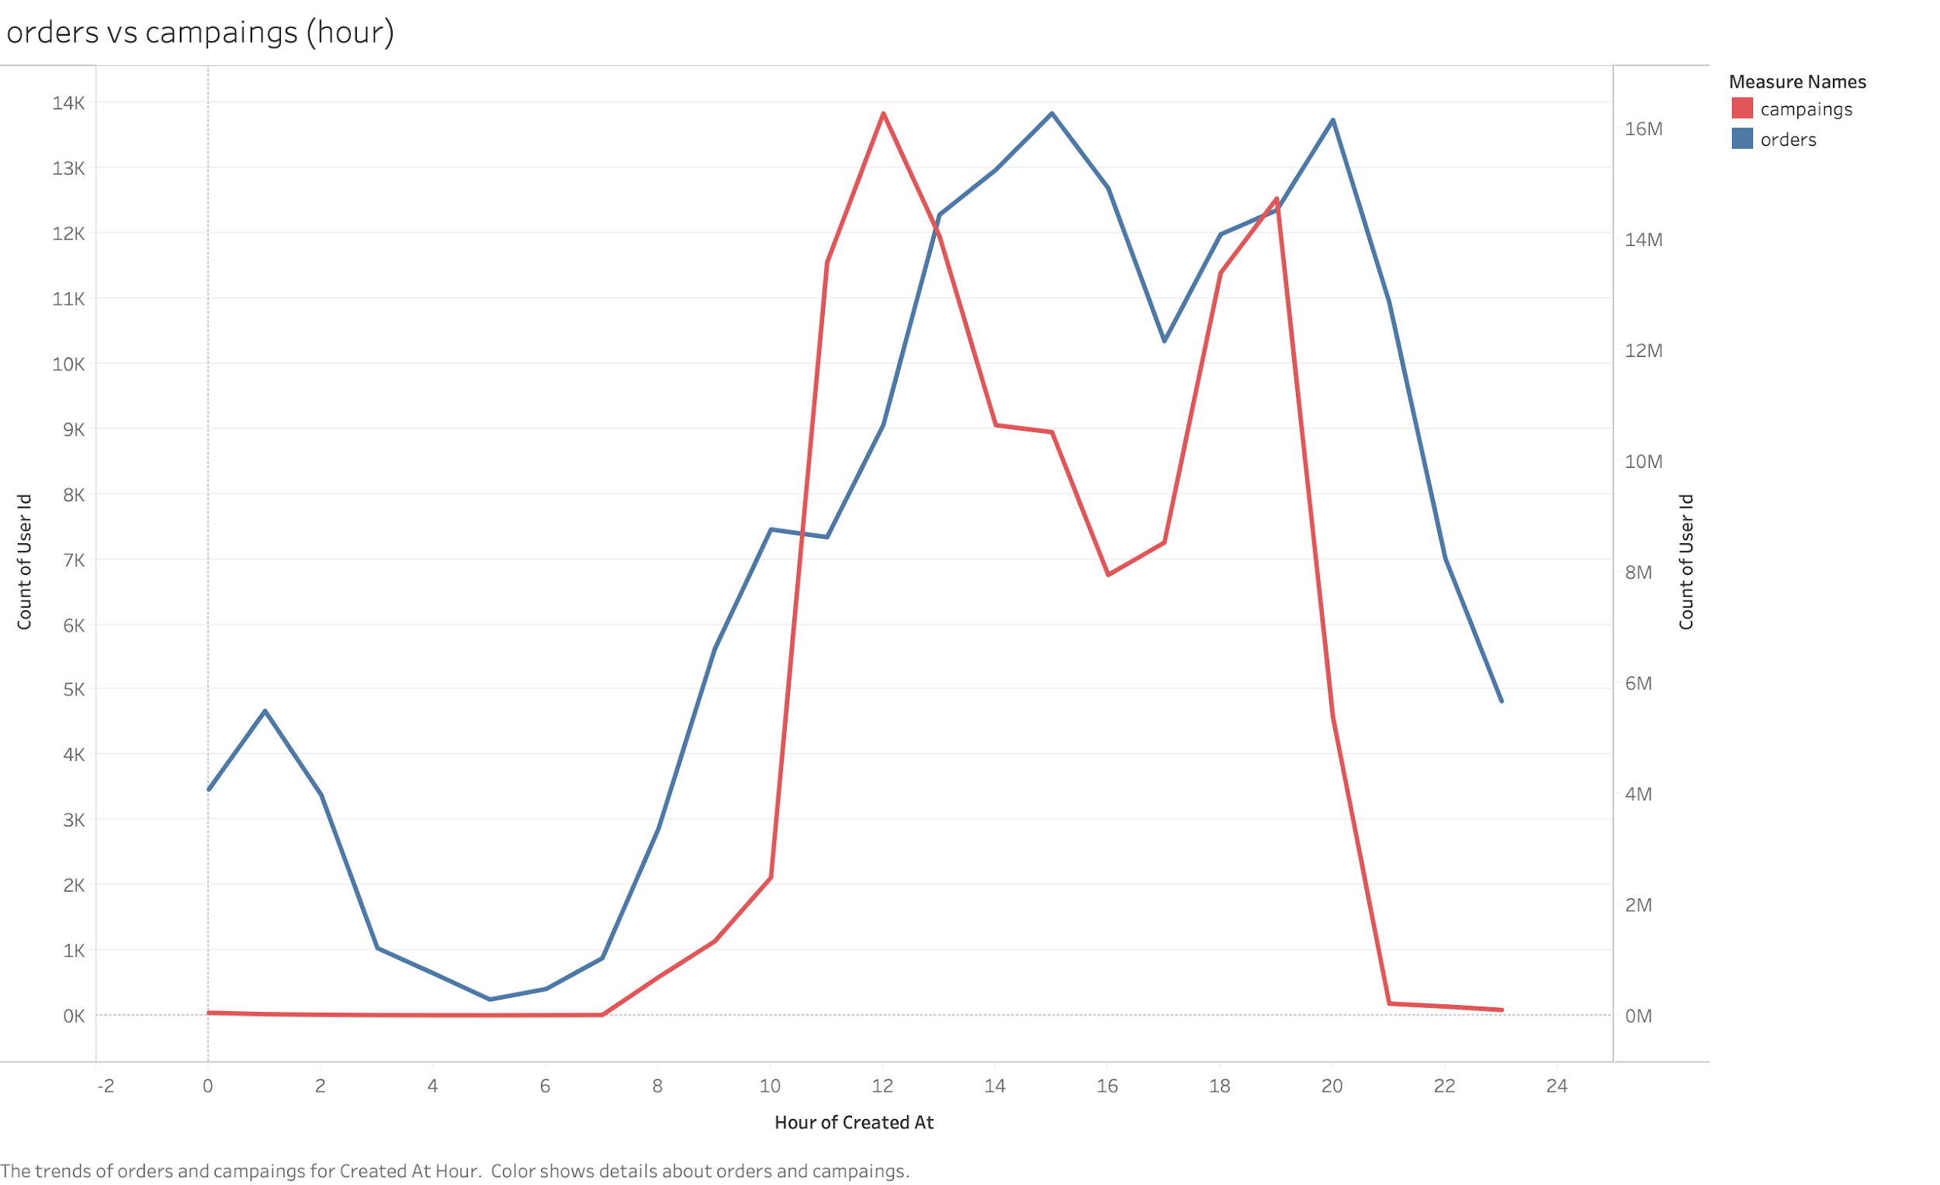

Rappi is sending the campaigns at the right time
Notes:
Iñaki
however, rappi is sending the campaigns in the right time. When there is a peak in the messages sent after comes a peak in the orders created, also when they stop sending campaigns the orders created drop.

Slide 21
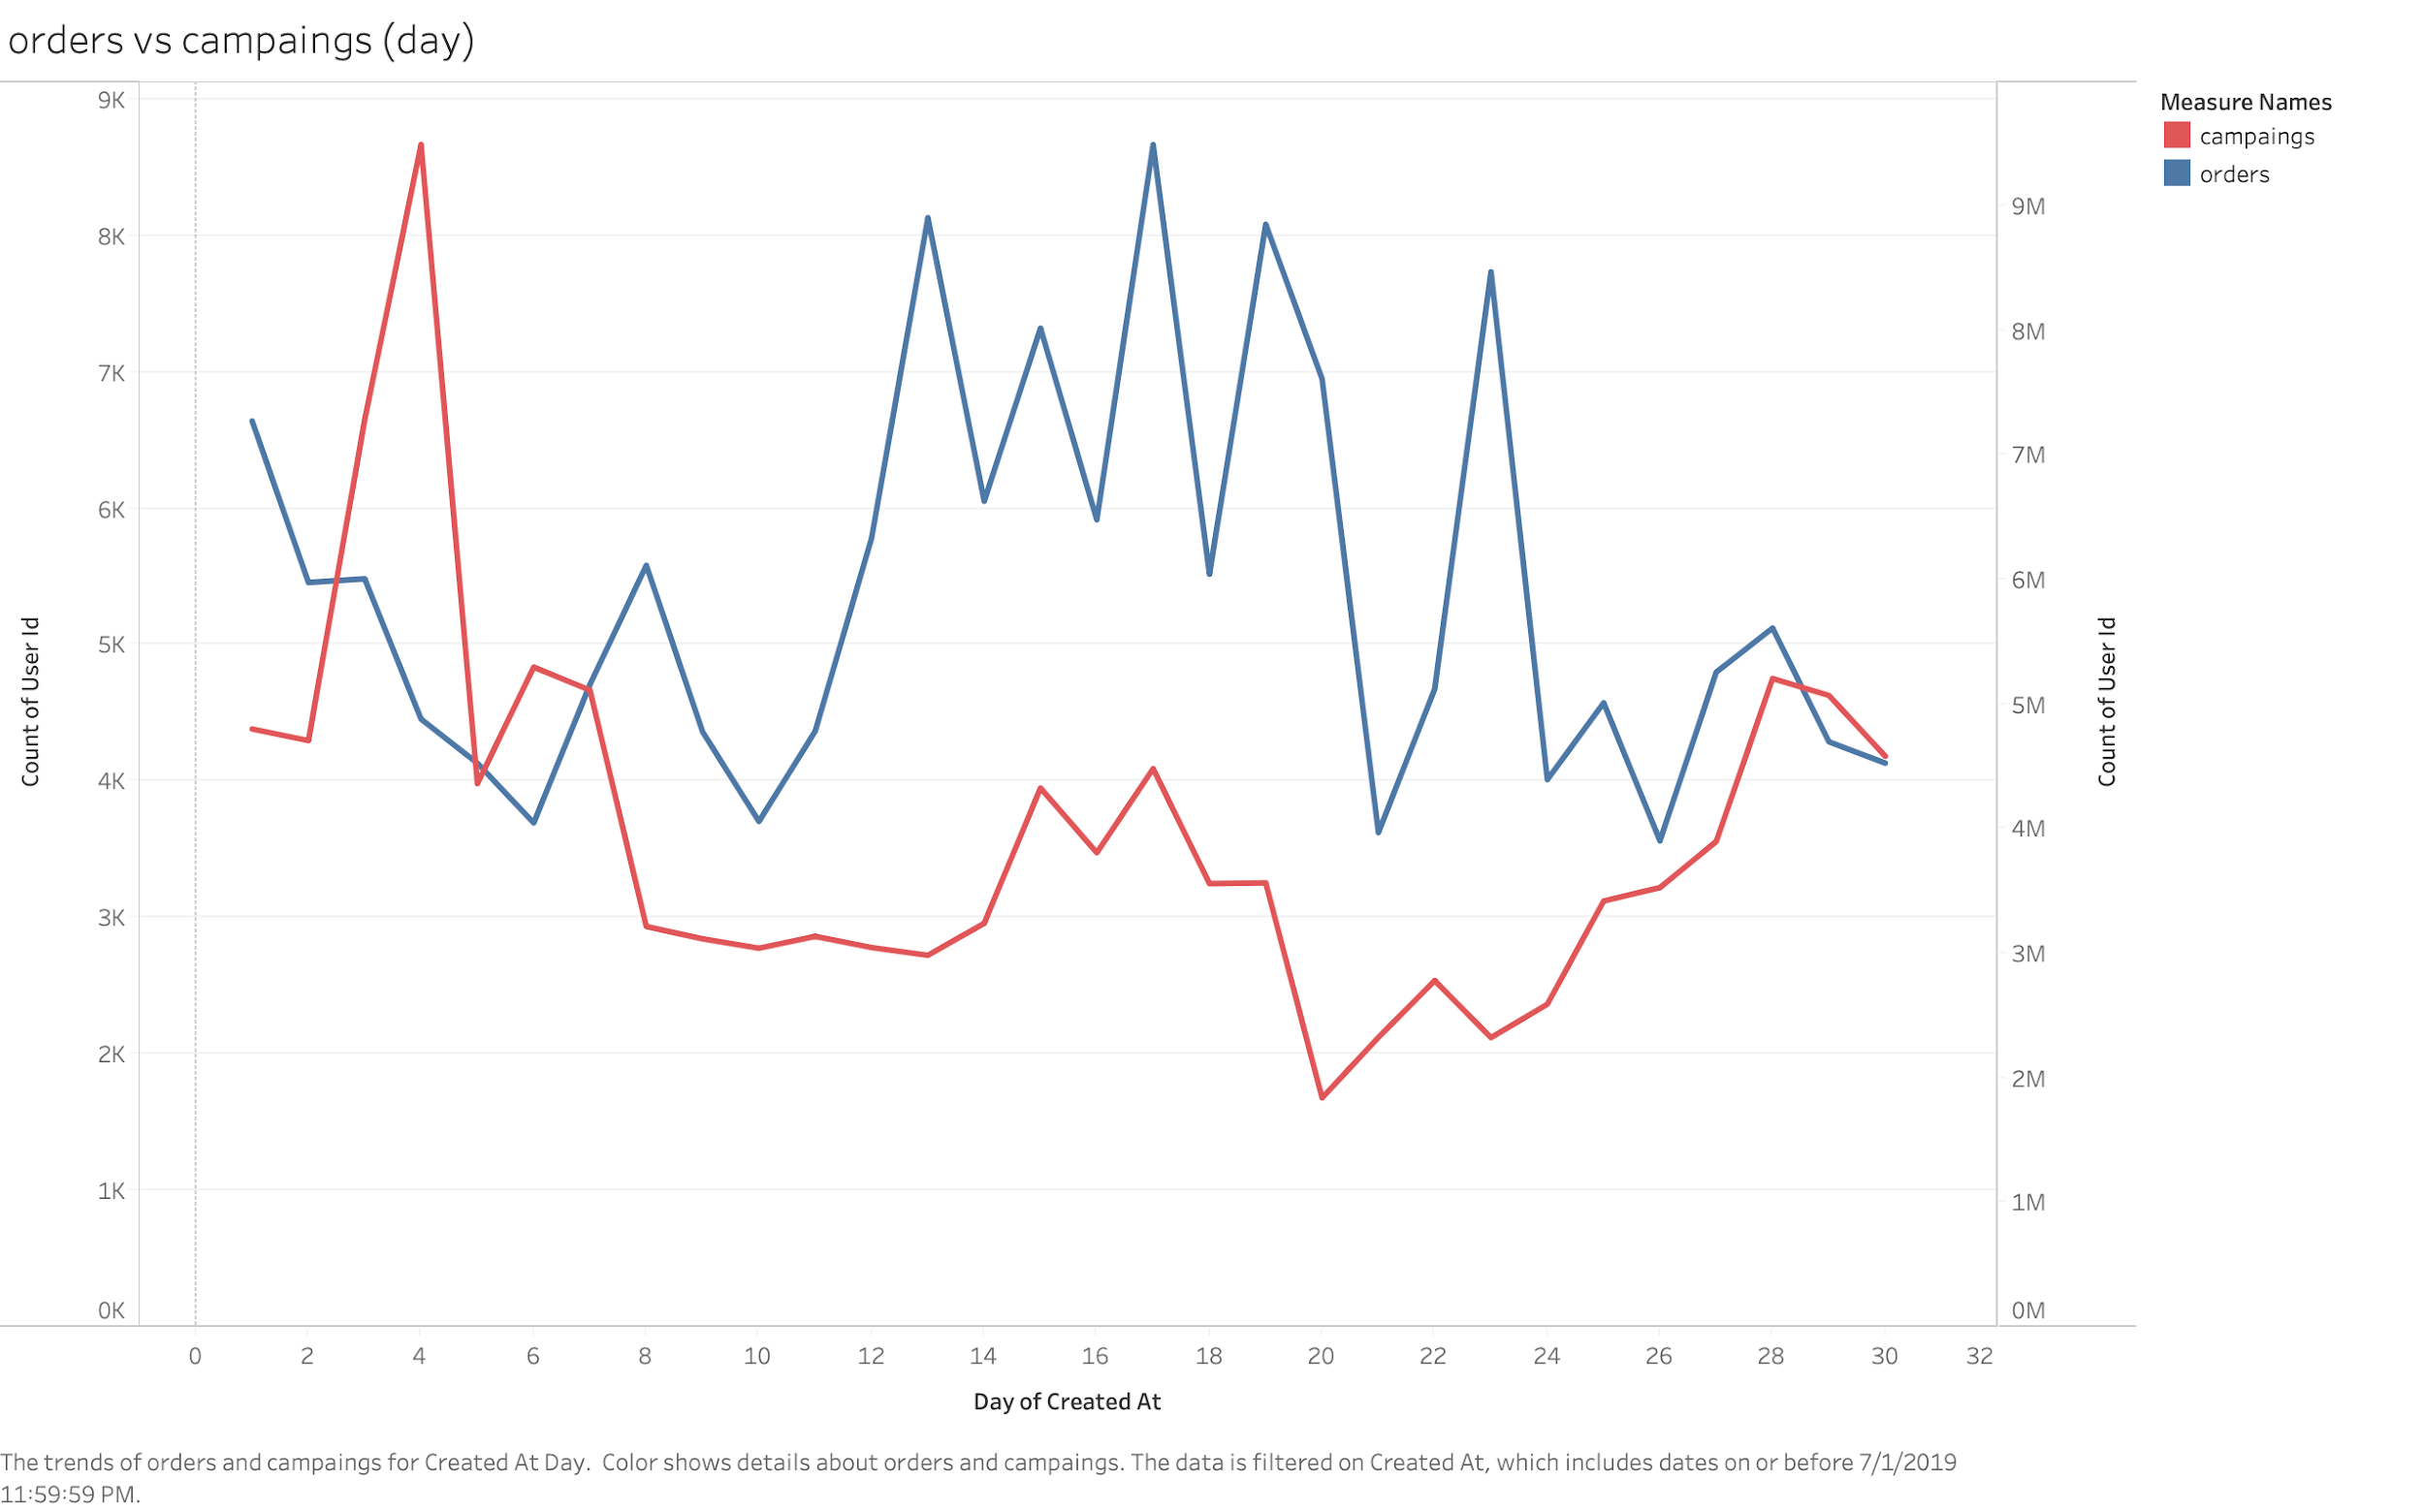
Rappi is sending campaigns on days in which customers don’t order as much
Notes:
Mariana

Slide 22
Our recommendations to Rappi
Rappi should create more women oriented marketing campaigns to increase the orders from their segment.
Marketing campaigns should motivate users to spend more rather than less.
ej. 10% discount for purchases larger than $100
Marketing campaigns might be more effective if sent through push notification.
Overall, push/sms notifications are not as effective in 18-30 year-olds
Rappi should send campaigns at 5 pm.
Rappi should send out campaigns at the beginning and at the middle of the month.
Notes:
Mariana

Slide 23
What questions remain?
What were the parameters considered for the distribution of each campaign?
Were campaigns really trying to reach out to specific user segments?
Which campaigns were oriented toward certain age groups? Did they work?
Notes:
Bruno
users targeted? parameters?
specific user segments vs general
if specific, work?

Slide 24



Questions

